Slide 1


Slide 2


Disclaimer
CONFIDENTIALITY AGREEMENT
All information disclosed by FOCUSEDEXP AGENCY during the course of this presentation / in this document, whether in documented or oral form is confidential (“the Confidential Information”). The recipient agrees to ensure and take all necessary precautions to procure that the secrecy and confidentiality of the Confidential Information is maintained by it, its employees, agents and/or officers. No part of the Confidential Information shall be used or exploited, directly or indirectly, by the Recipient its employees, agents and/or officers, in any way or for any purpose. The Recipient agrees to indemnify FOCUSEDEXP AGENCY against any loss, liability, damage or expenses which it may suffer as a result of, or which may be attributed to any intentional or unintentional disclosure of the Confidential Information to any third person, and/or the use of the Proprietary Information by the recipient, its employees, agents and/or officers. This agreement shall be construed and enforced in accordance with the laws.
COPYRIGHT
The content of this document is proprietary to FOCUSEDEXP AGENCY and is subject to copyright. This document is not to be reproduced, copied, disclosed, transmitted, in any form, by any means, in whole or in part, without the express prior written consent of FOCUSEDEXP AGENCY
Copyright

Slide 3

Our Vision
To be the most preferred Agency in
term of quick & quality delivery in
integrated marketing communications
(IMC).

Slide 4

Deeply engraved in the “art” of thinking outside the box “contexts”, while driving high values, integrity, quality service delivery and dependability.
Our Mission

Slide 5

Quick turnaround and ability to go extra miles in customers satisfaction without compromising quality delivery
Our Value

Slide 6

What we do
Corporate brand Identity development and implementation
Brands advisory
Full integrated Marketing communication development and implementation
Advertising and Public Relations
Design works
Digital/multimedia designs
BTL (below the line) production
ATL (Above the line) Production

Slide 7

Business Development Unit Creative Unit
Research Art Visualizing Brain Storming
Strategic Planning Strategy
Marketing Copy Writing
Account Management/Client Services Art Direction
Operational structure:
Media Unit Production Unit
Media Planning/Strategy Production Planning
Budget Development & Implementation Budgeting
Media Buy Quantity Control
At Focused Exp Agency, we are strategically structured to deliver excellent solutions with impressive turn around time. We are modeled thus:
Finance Unit Administrative Unit
Budgeting & Implementation Internal Communications
Recruitments & Training
Maintenance
Human Resources Development

Slide 8


















The Brands We Keep

Slide 9

Creative Portfolio

Slide 10



Press Ad

Slide 11



Press Ad

Slide 12



Press Ad

Slide 13


Press Ad

Slide 14



Flyers

Slide 15



Flyers

Slide 16



Flyers

Slide 17


Calendars

Slide 18


Calendars

Slide 19



Magazine

Slide 20

Brochure

Slide 21

Brochure

Slide 22


Brochure

Slide 23


Brochure

Slide 24

Brochure

Slide 25

Xmas card

Slide 26


Outdoor

Slide 27
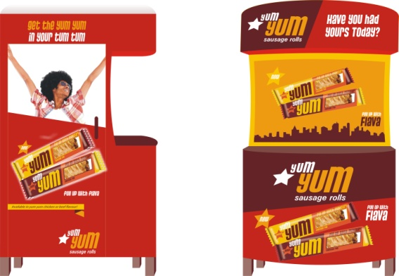
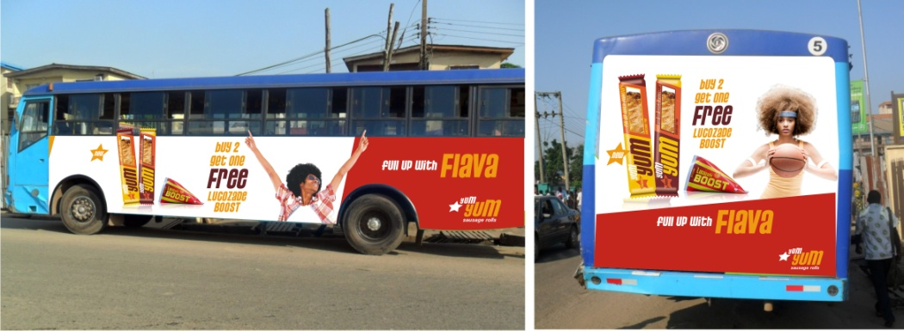


Outdoor

Slide 28

Website Design

Slide 29
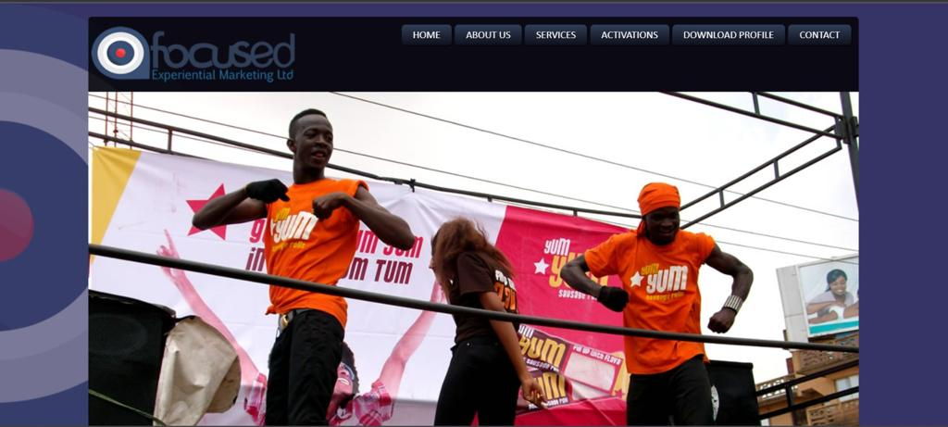
Website Design

Slide 30

Website Design

Slide 31


Contact…
Address:
Harrisburg, PA 17110
Email:
focused@focusedexp.com
rufus.aluko@focusedexp.com
Website:
focused@focusedexp.com
Key pedigree:
Over a decade of experiential branding and
activations across the continents

Slide 32


